Slide 1
Quant-Finance Training Session 15
Lecture 15-16 Risk

Slide 2
Table of Contents
1Risk
2Modeling Approach to Risk
3Astronomical Probabilities
4Multivariable Risk Analysis
5Coherent Risk Measures
6Value At Risk
7Simulation Methods for VaR

Slide 3
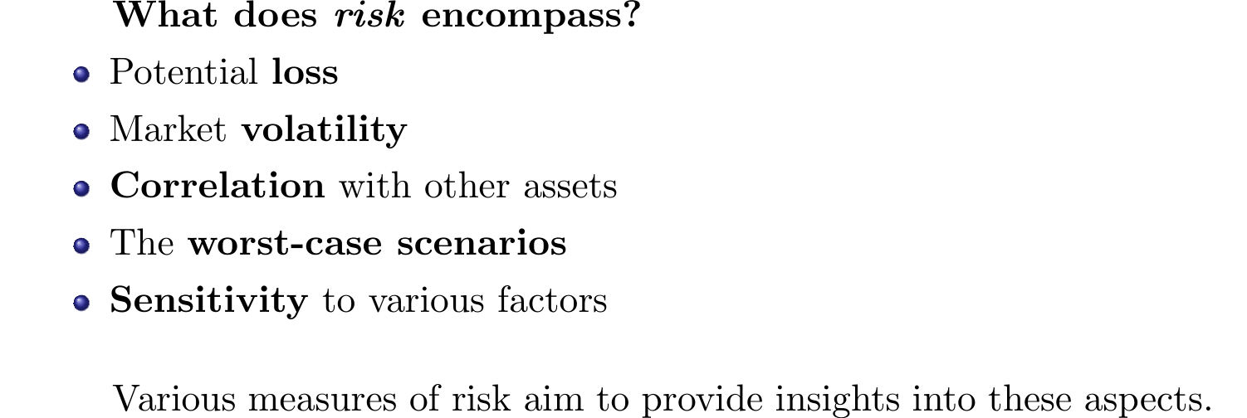
Understanding Risk

Slide 4
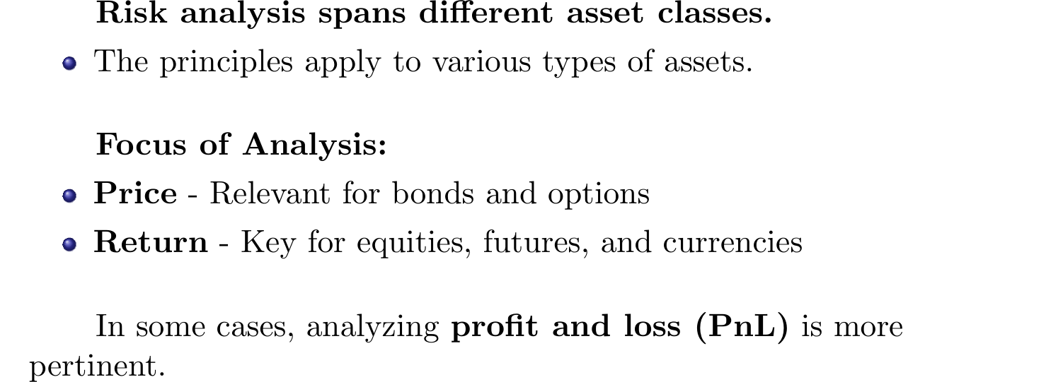
Return, Price, PnL, and Beyond

Slide 5
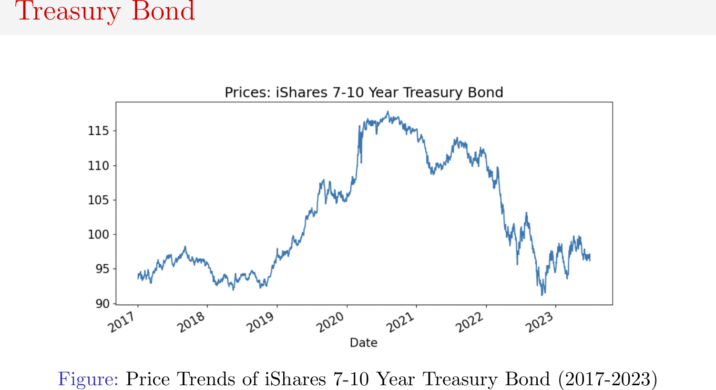
Price and Return Analysis of iShares 7-10 Year

Slide 6
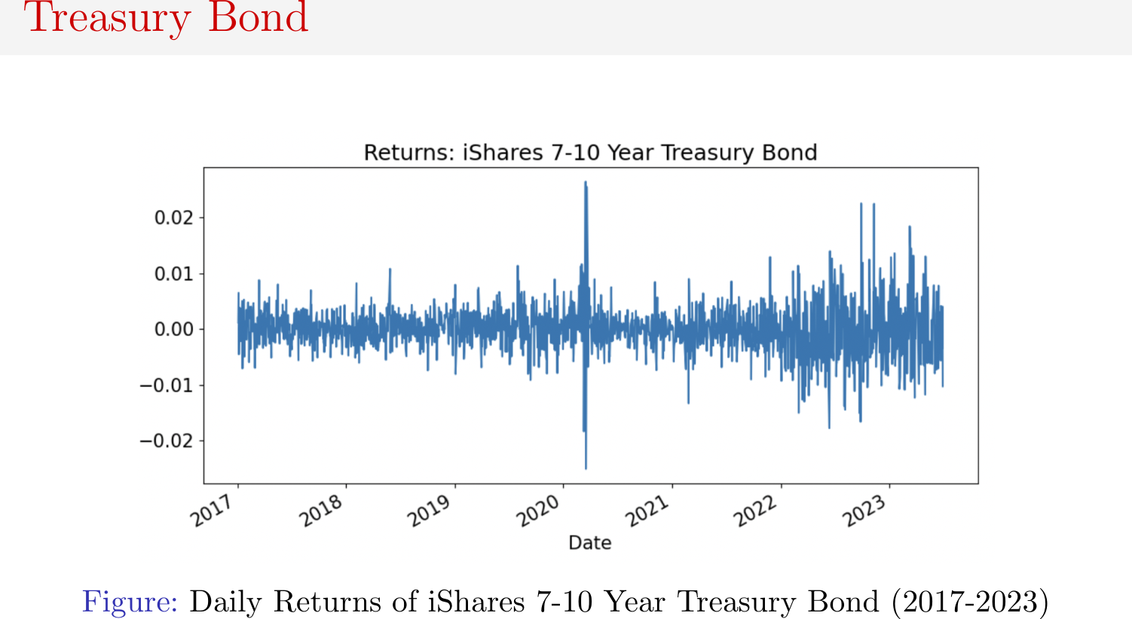
Price and Return Analysis of iShares 7-10 Year

Slide 7
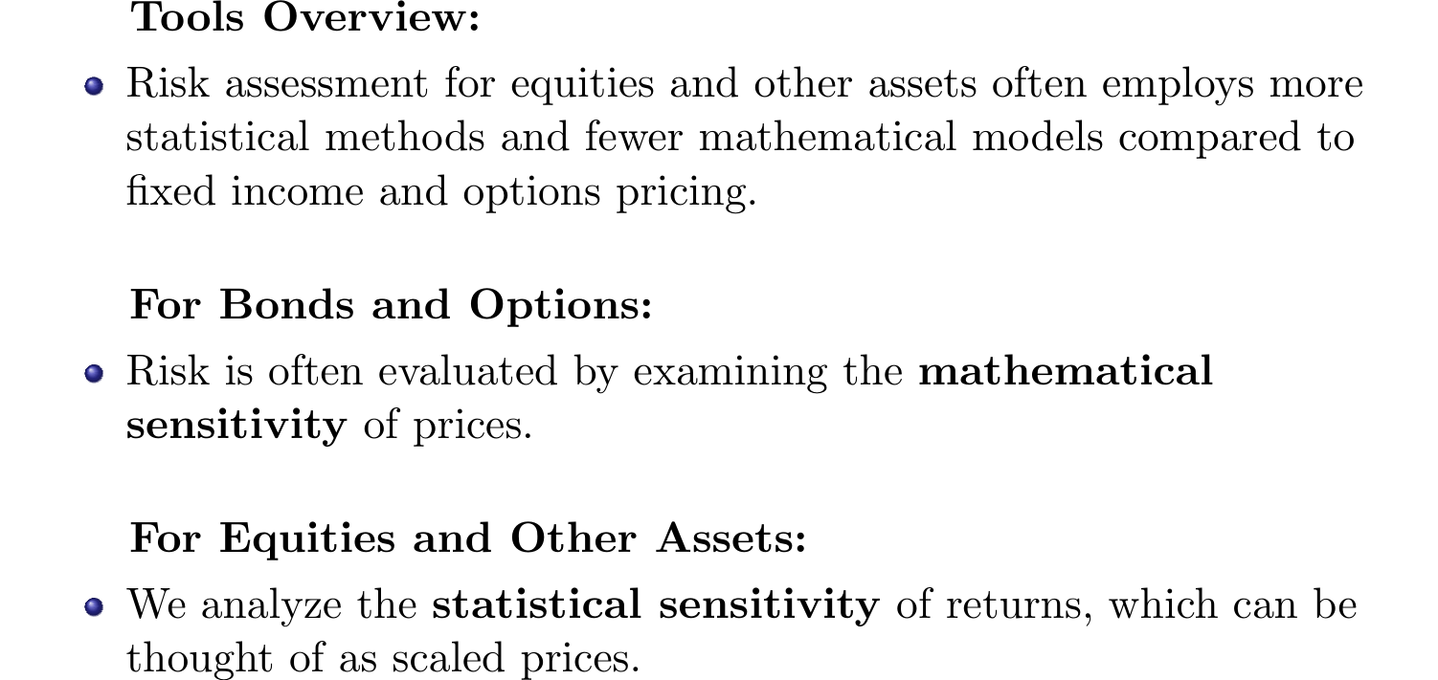
Tools for Risk Analysis

Slide 8
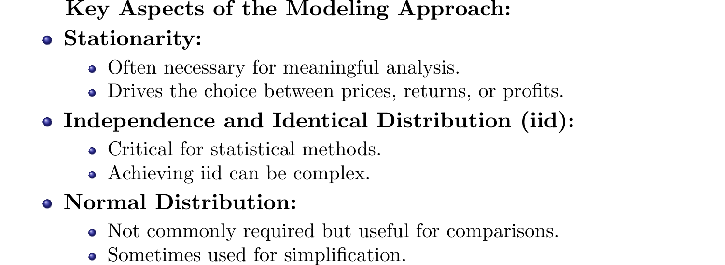
Modeling Approach to Risk

Slide 9
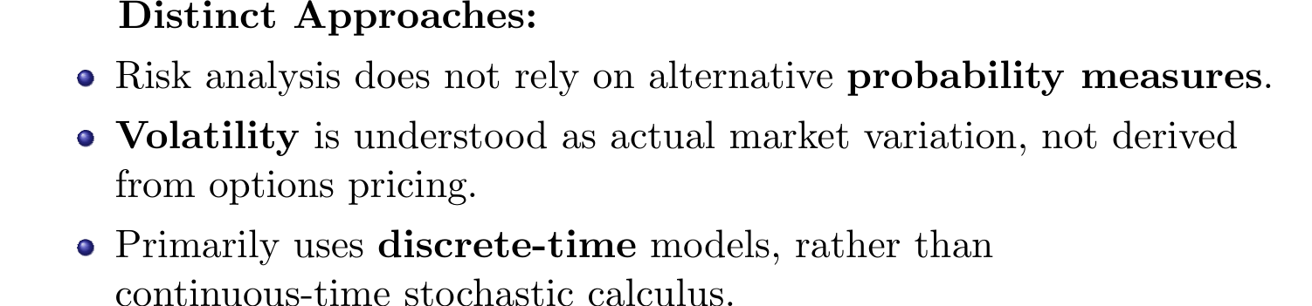
Risk Assessment versus Pricing

Slide 10
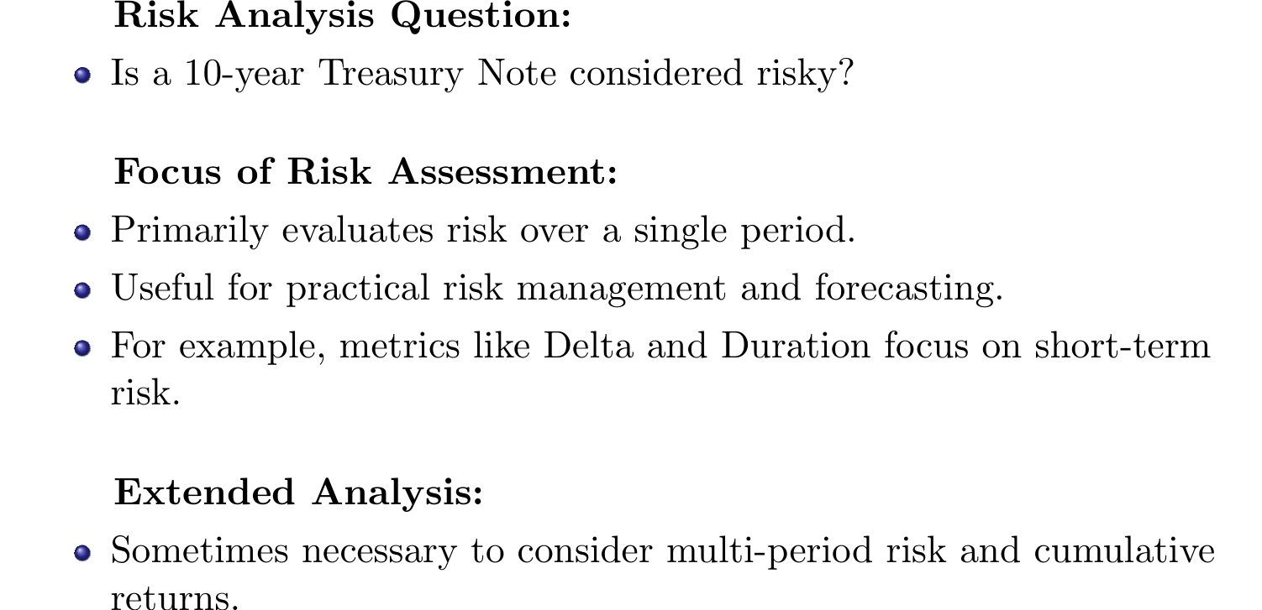
Initial Considerations in Risk Analysis

Slide 11
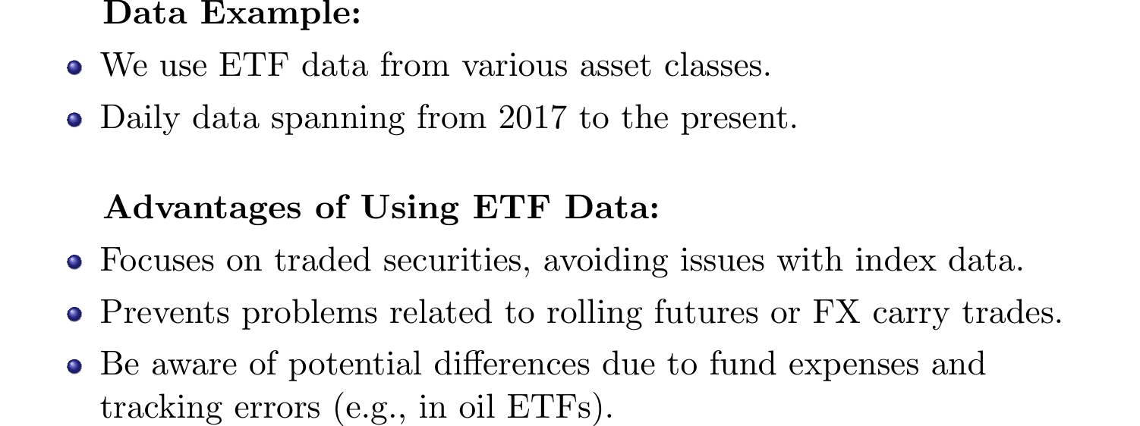
Moments and Data for Risk Analysis

Slide 12
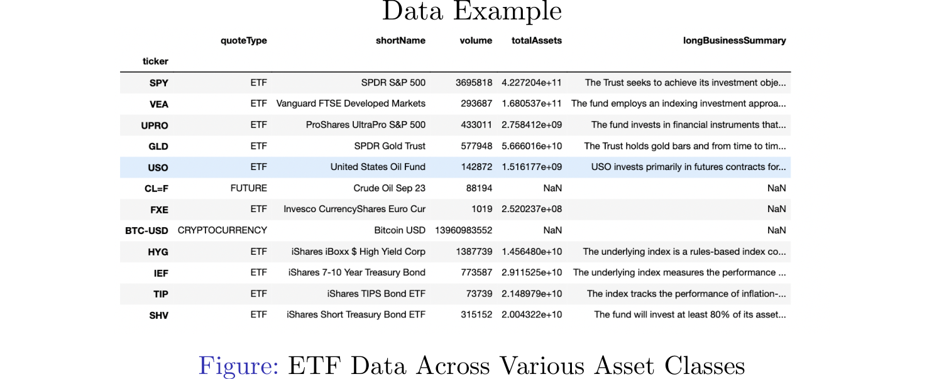
Data Example

Slide 13
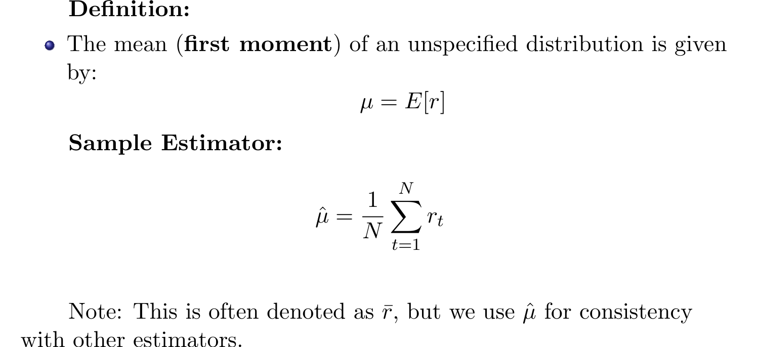
The Mean: First Moment of a Distribution

Slide 14
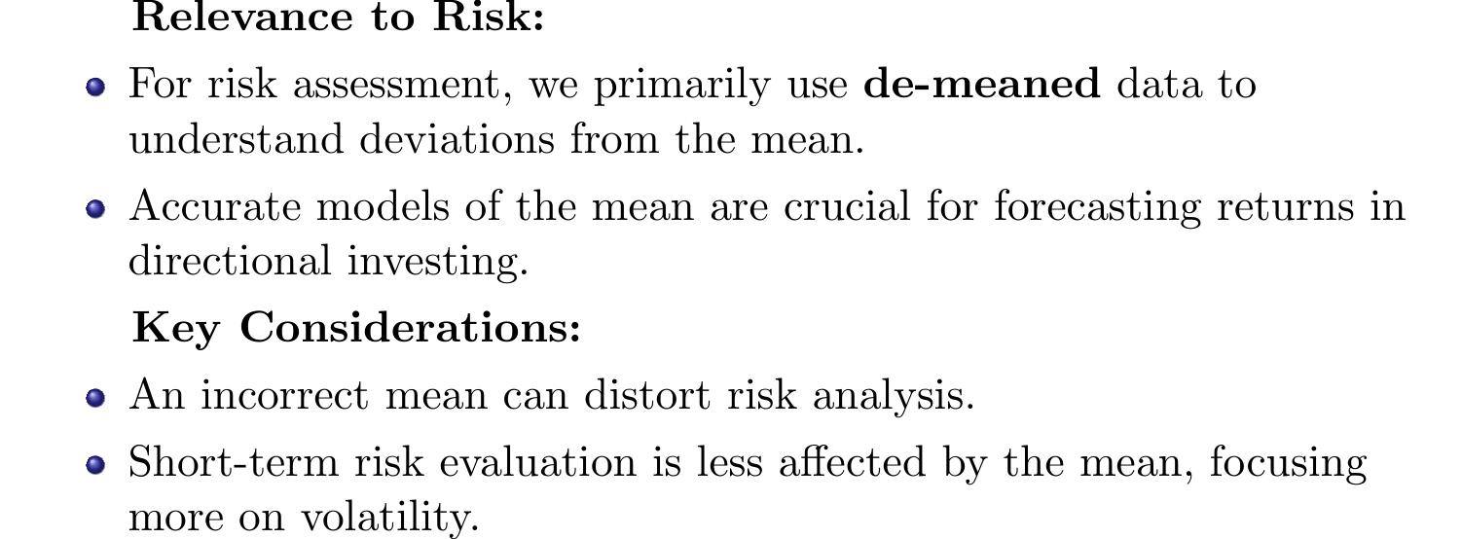
Importance of Mean in Risk Analysis

Slide 15
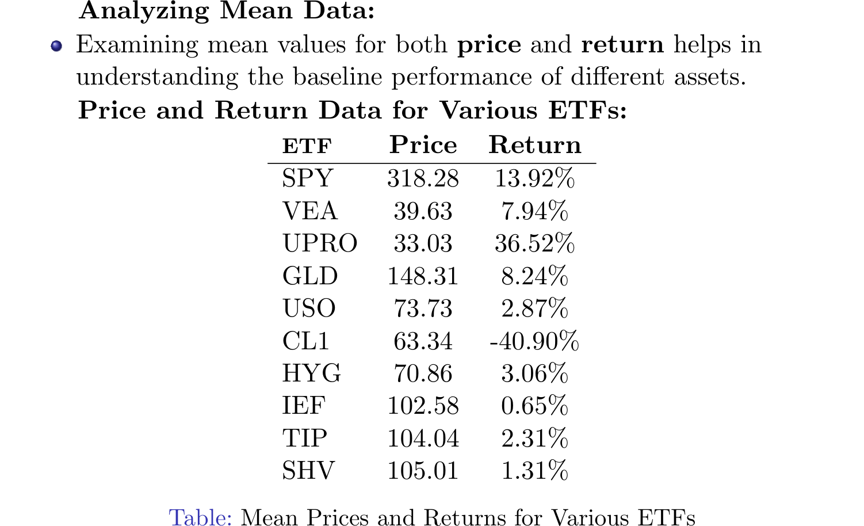
Mean Data for ETFs

Slide 16
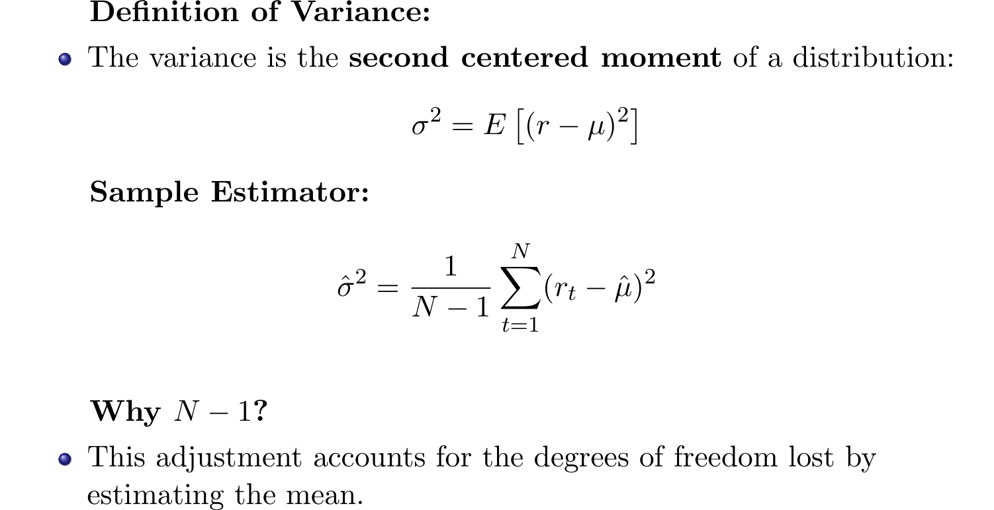
Variance and Volatility

Slide 17
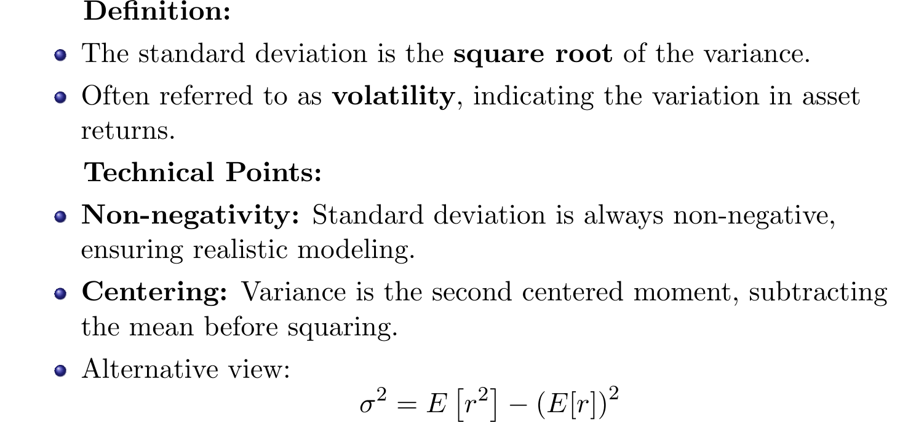
Standard Deviation and Volatility

Slide 18
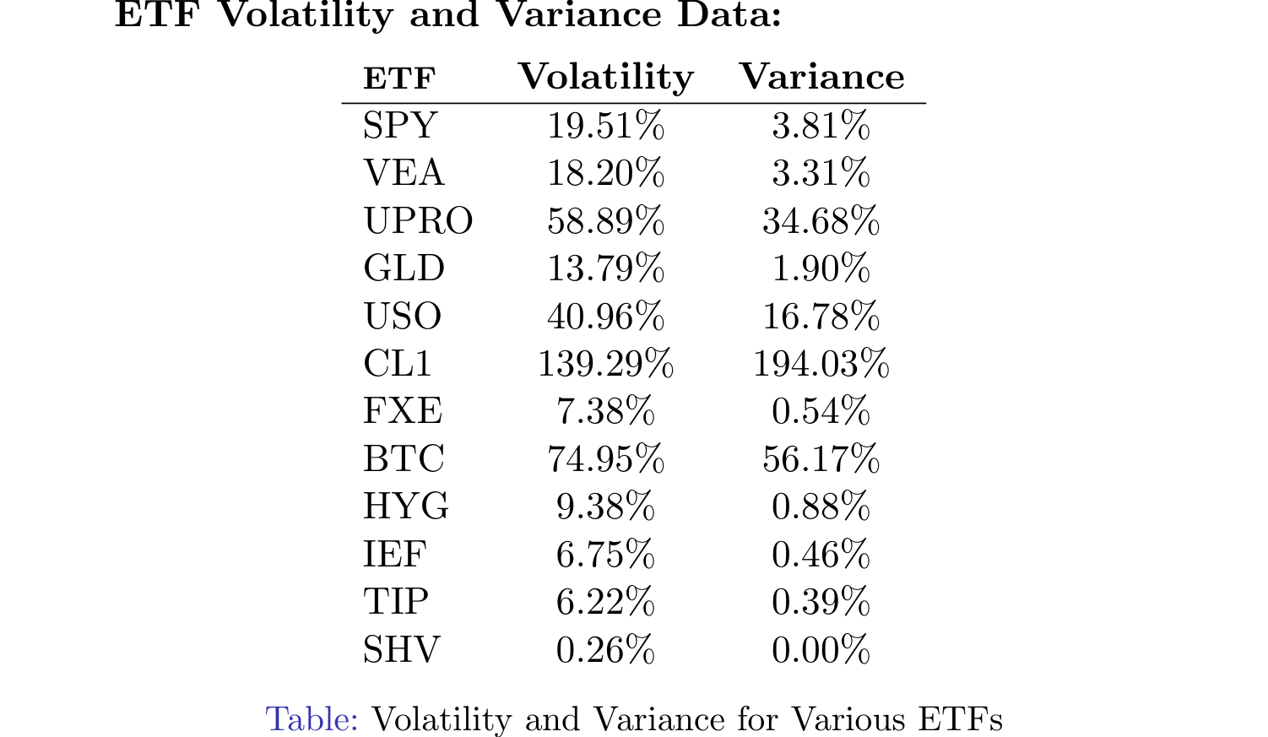
Volatility and Variance for ETFs

Slide 19
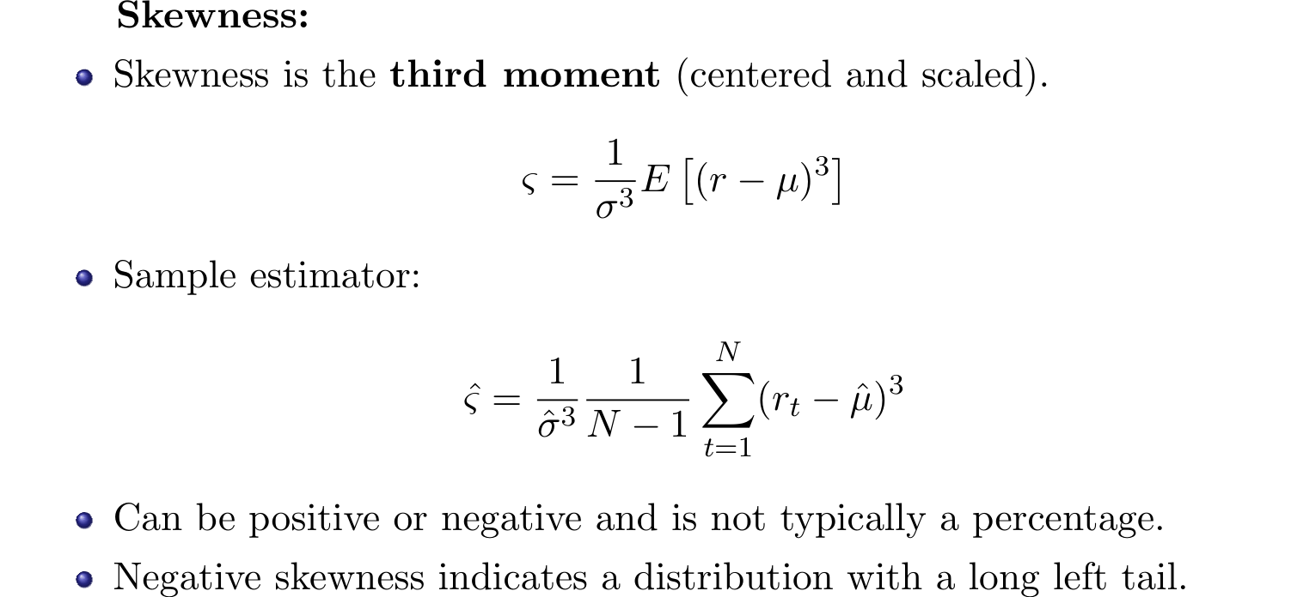
Higher Moments: Skewness and Kurtosis

Slide 20
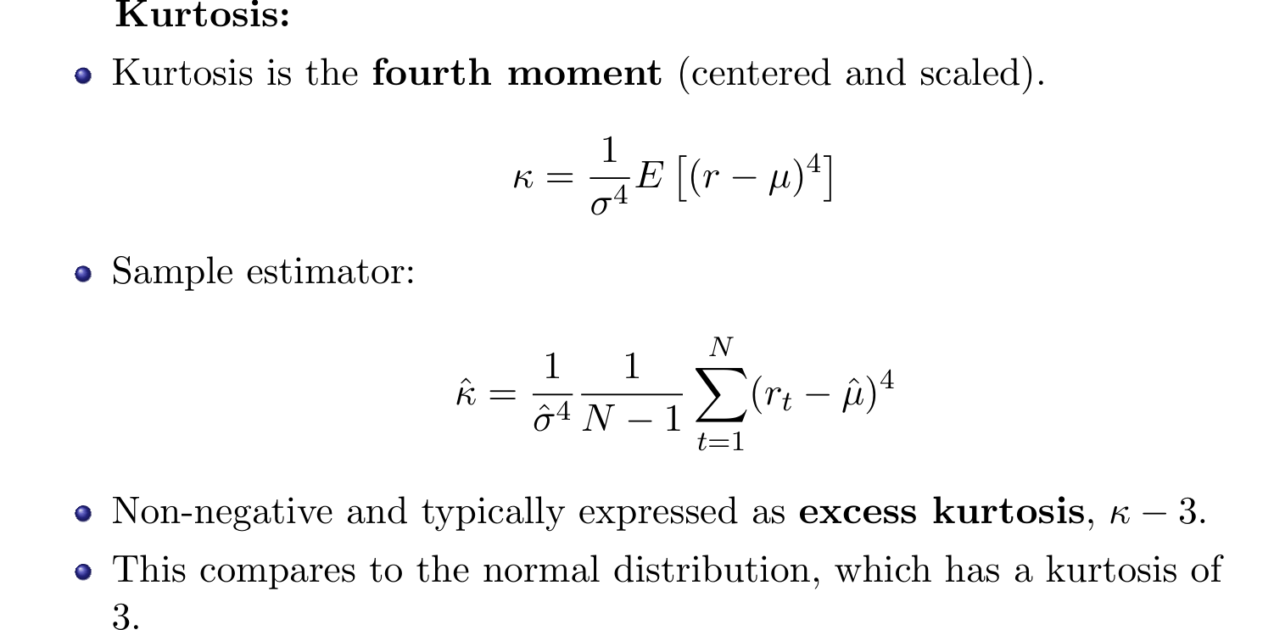
Kurtosis

Slide 21
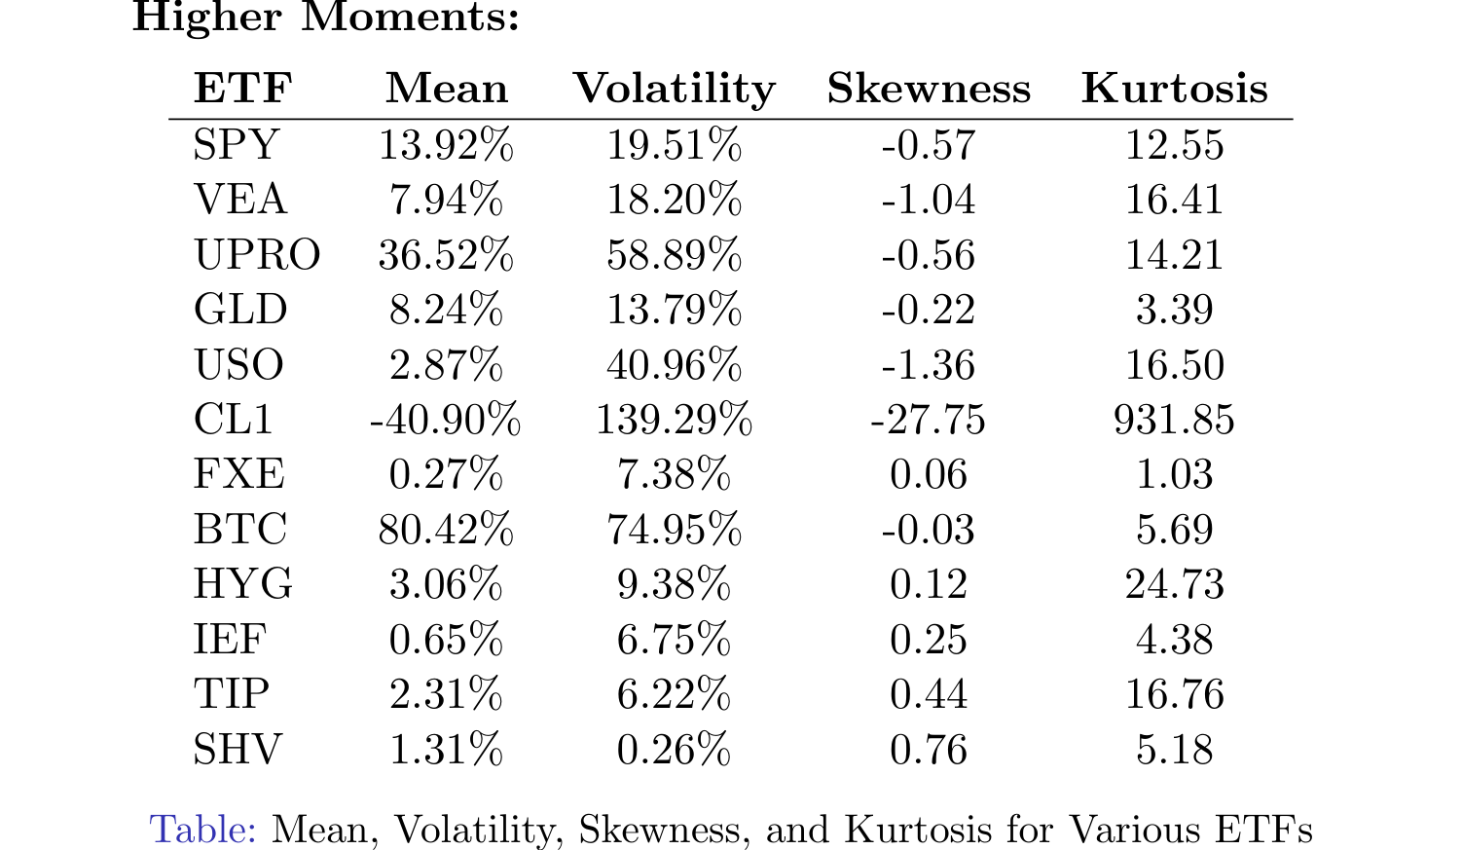
Higher Moments Data for ETFs

Slide 22
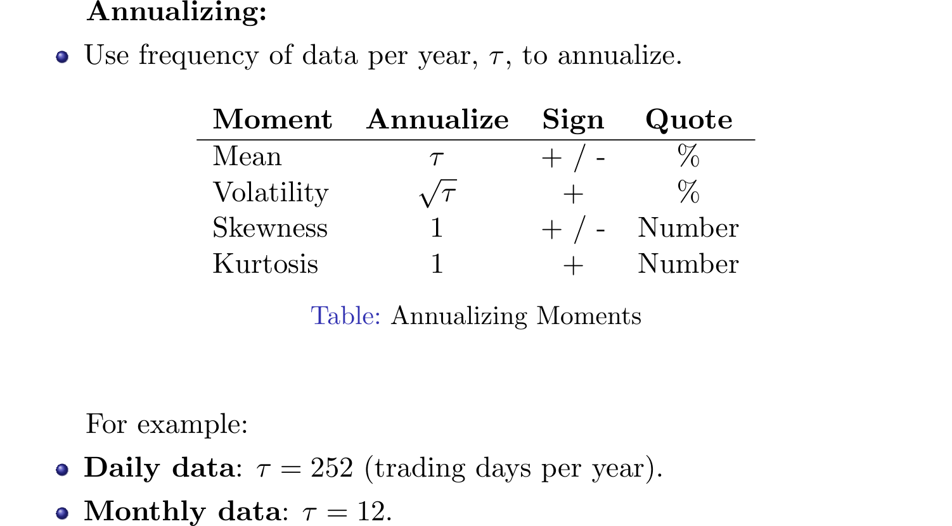
Annualizing Moments

Slide 23
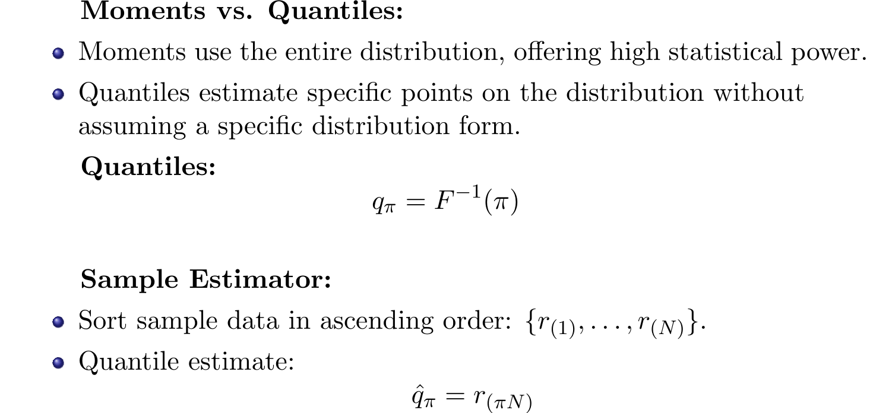
Distribution and Quantiles

Slide 24
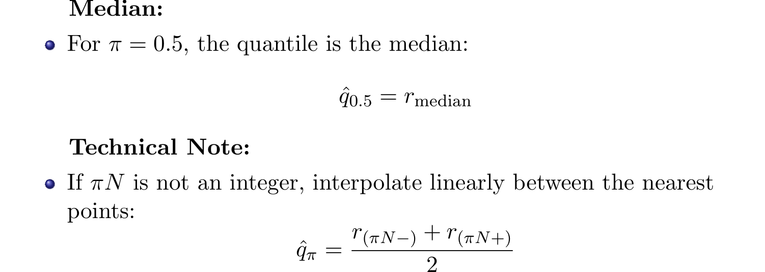
Median and Quantiles

Slide 25
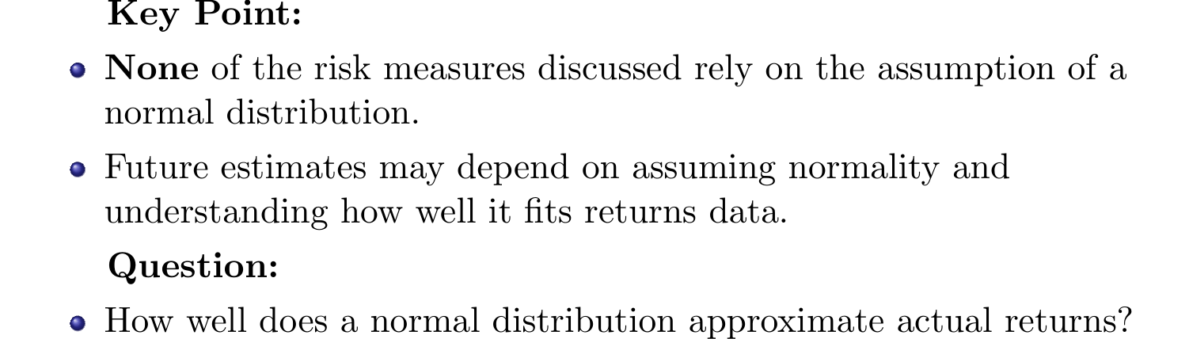
Normal Distribution and Returns

Slide 26
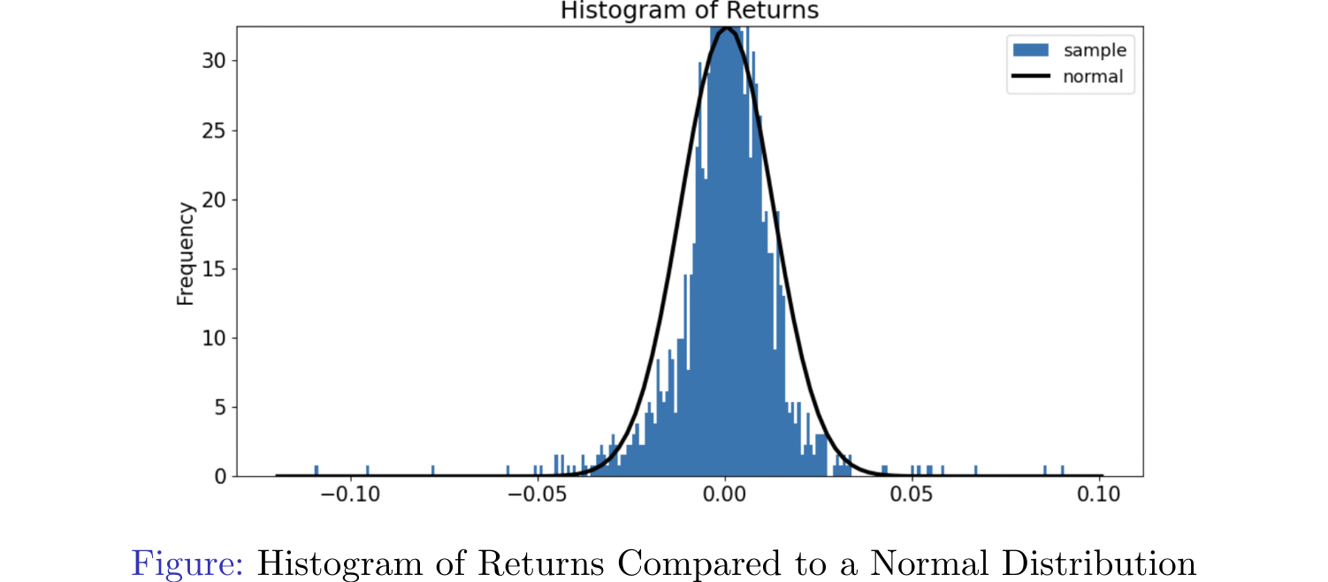
Returns vs Normal Distribution

Slide 27
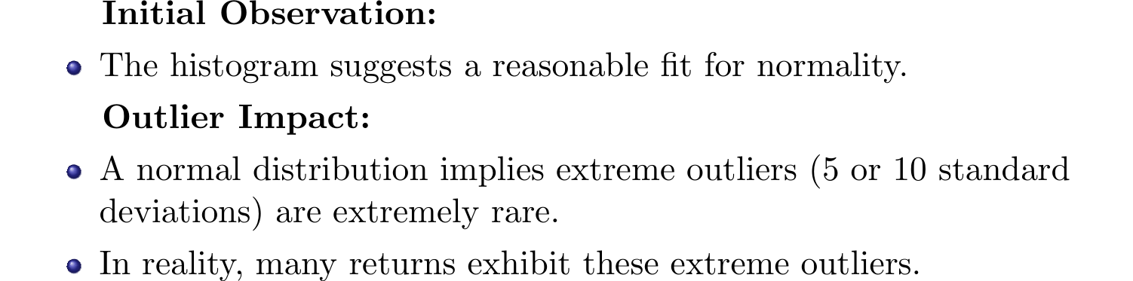
Considering Outliers

Slide 28
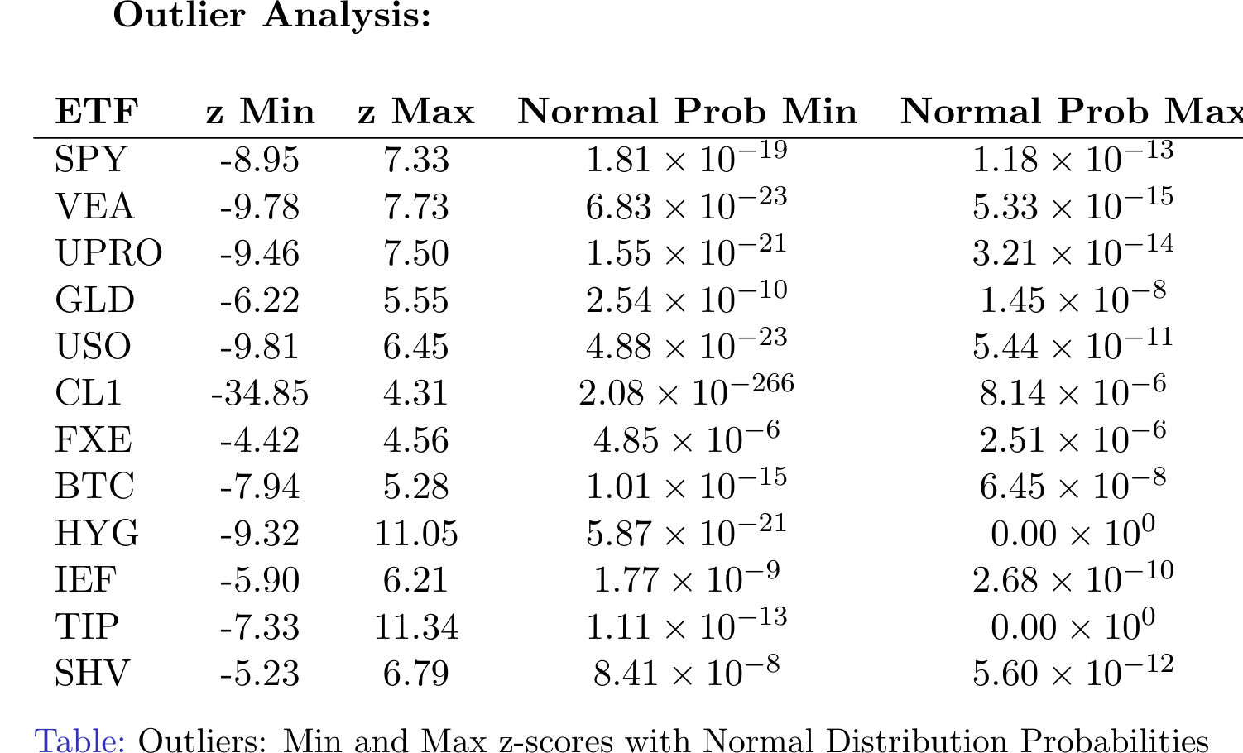
Outlier Analysis

Slide 29
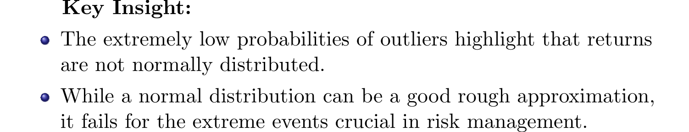
Astronomical Probabilities

Slide 30
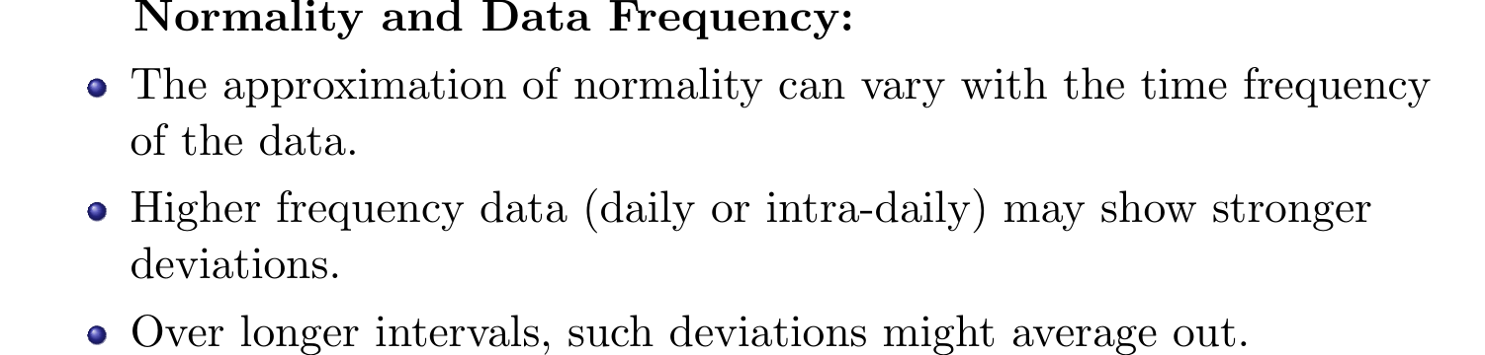
Impact of Time Frequency on Normality

Slide 31
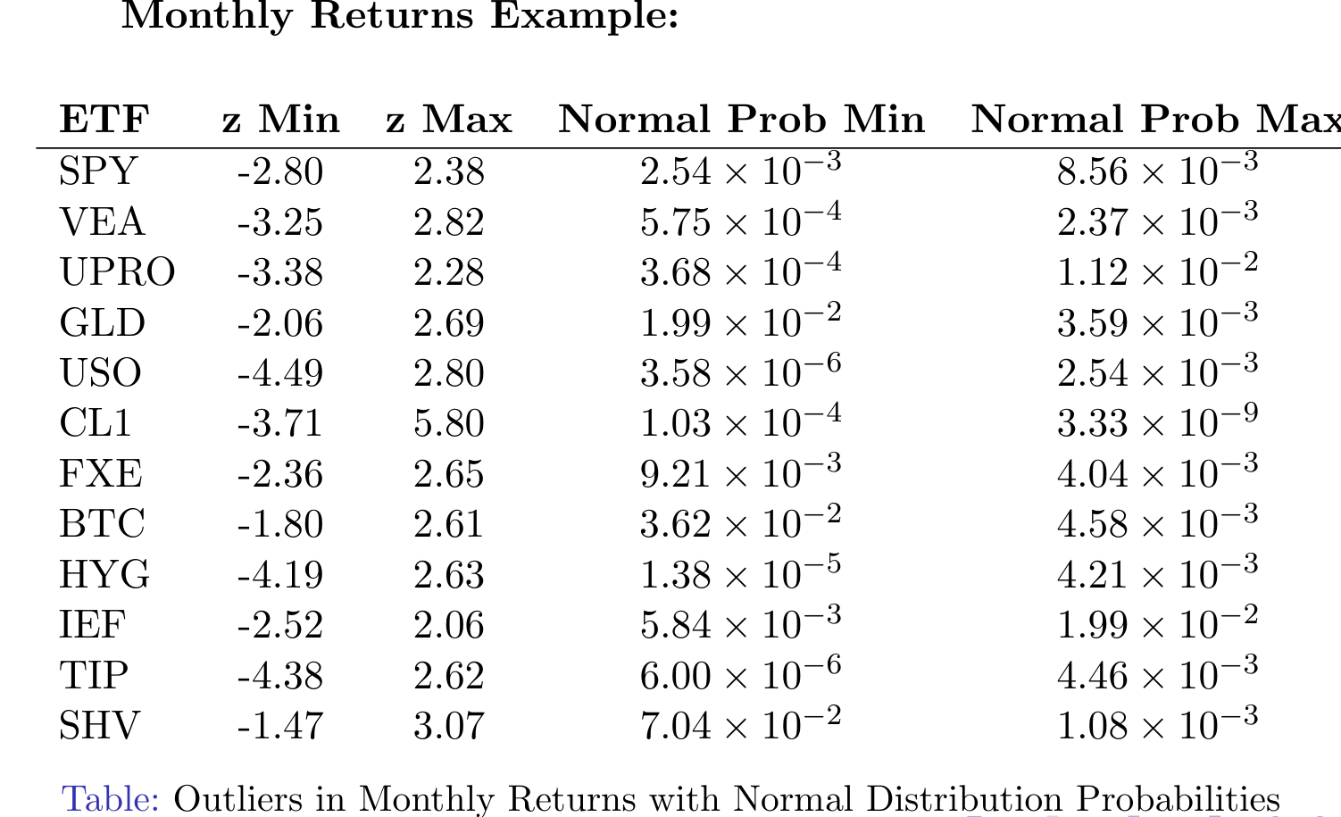
Monthly Returns Example

Slide 32
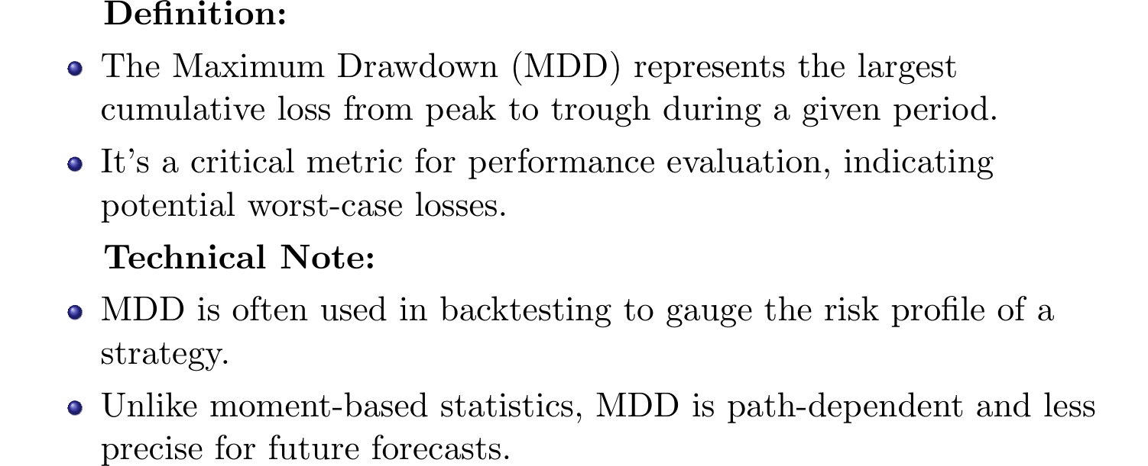
Maximum Drawdown

Slide 33
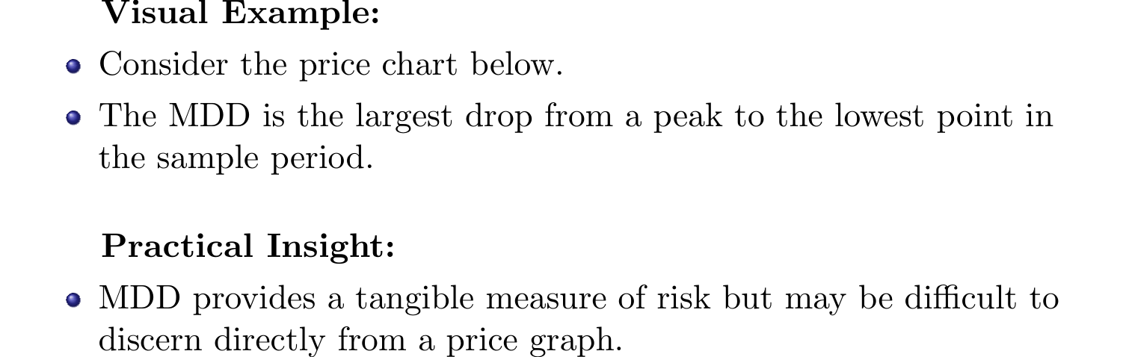
Maximum Drawdown Example

Slide 34
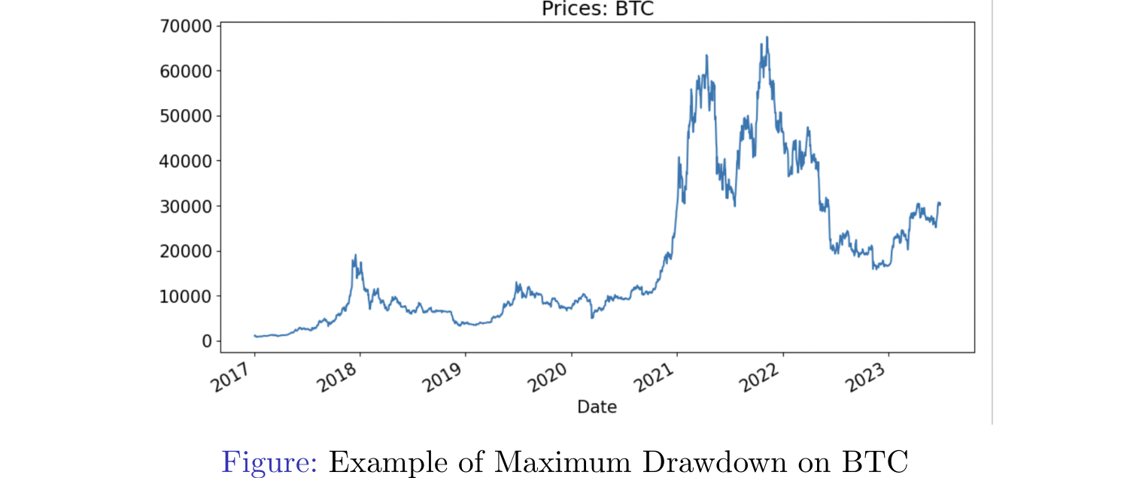
Figure: Example of Maximum Drawdown on BTC

Slide 35
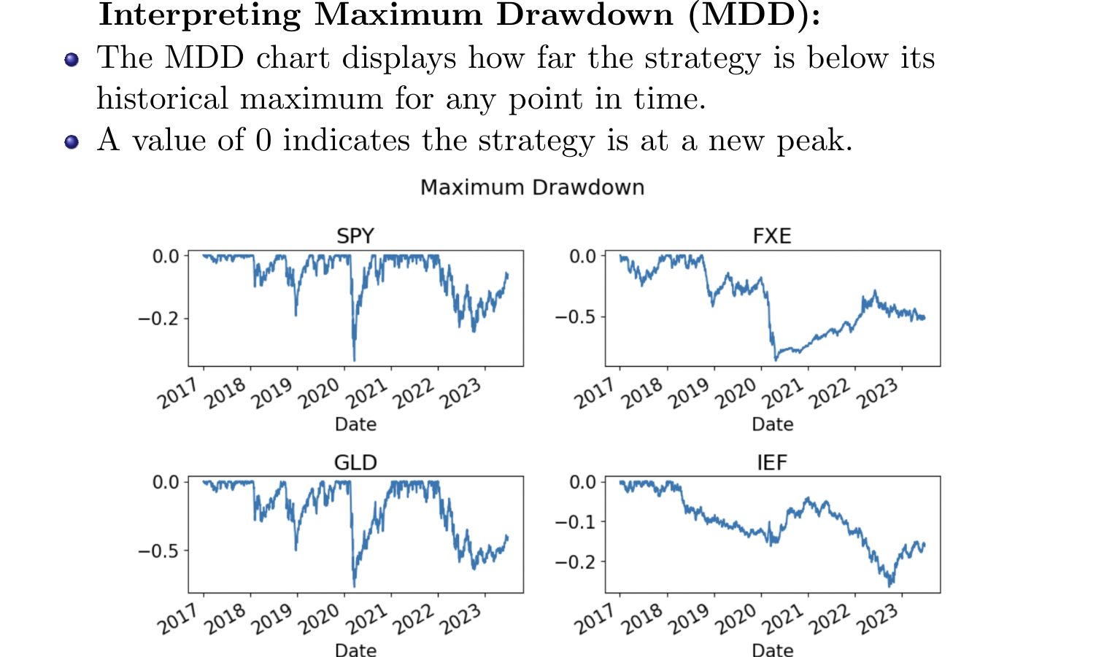
Maximum Drawdown Analysis

Slide 36
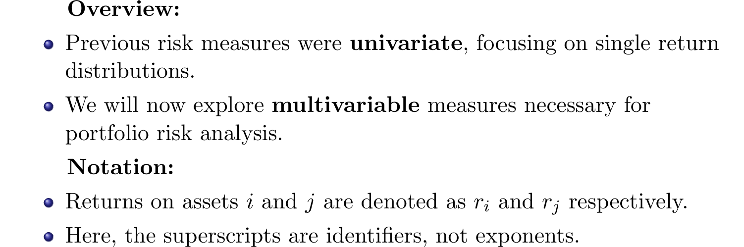
Multivariable Risk Analysis

Slide 37
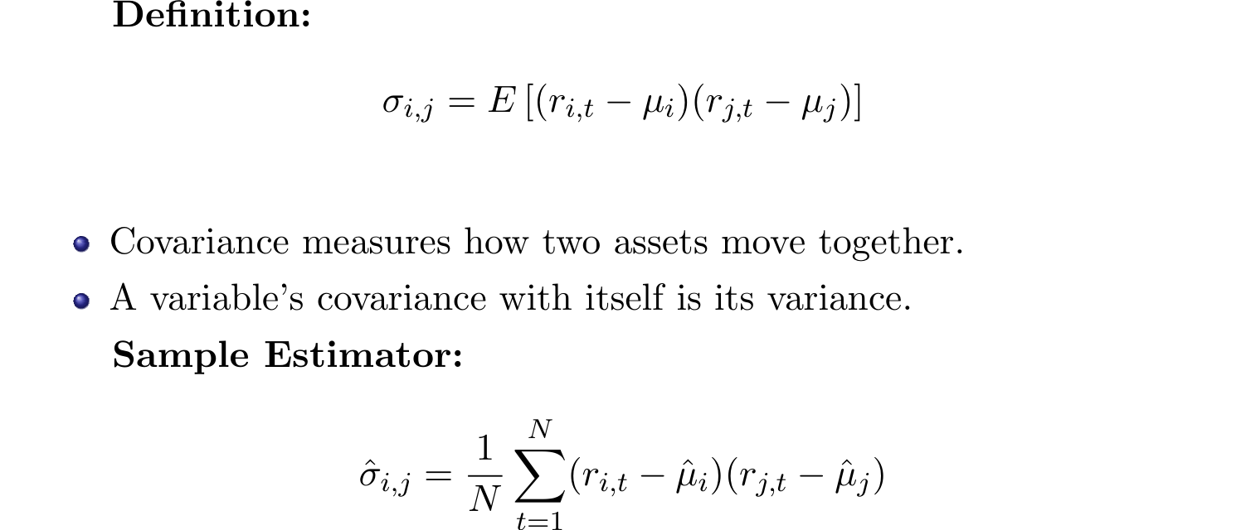
Covariance: Understanding Asset Relationships

Slide 38
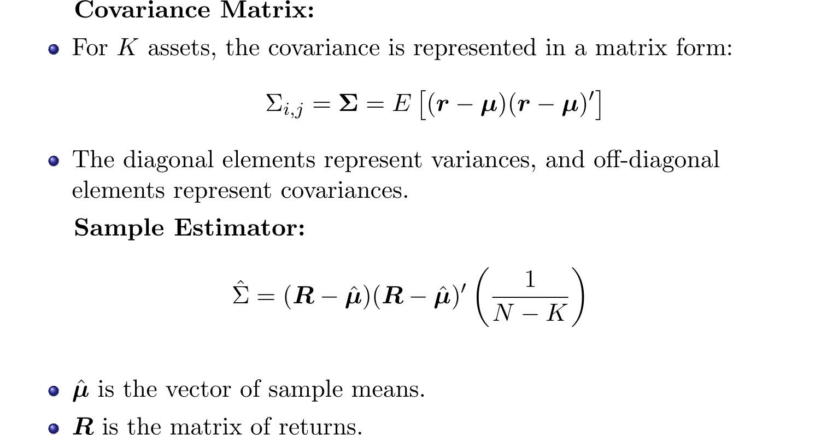
Covariance Matrix: A Multivariable Approach

Slide 39
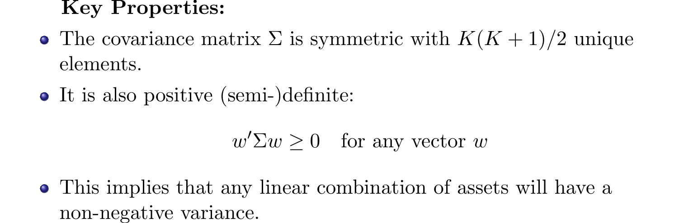
Technical Properties of the Covariance Matrix

Slide 40
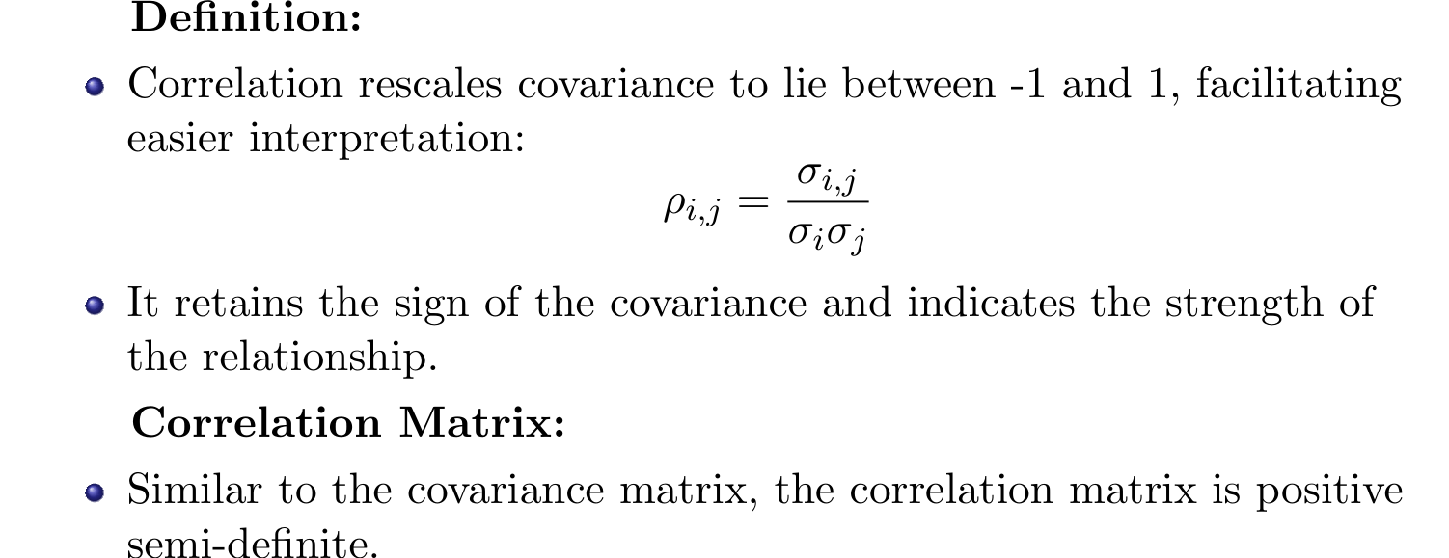
Correlation: Scaling Covariance

Slide 41
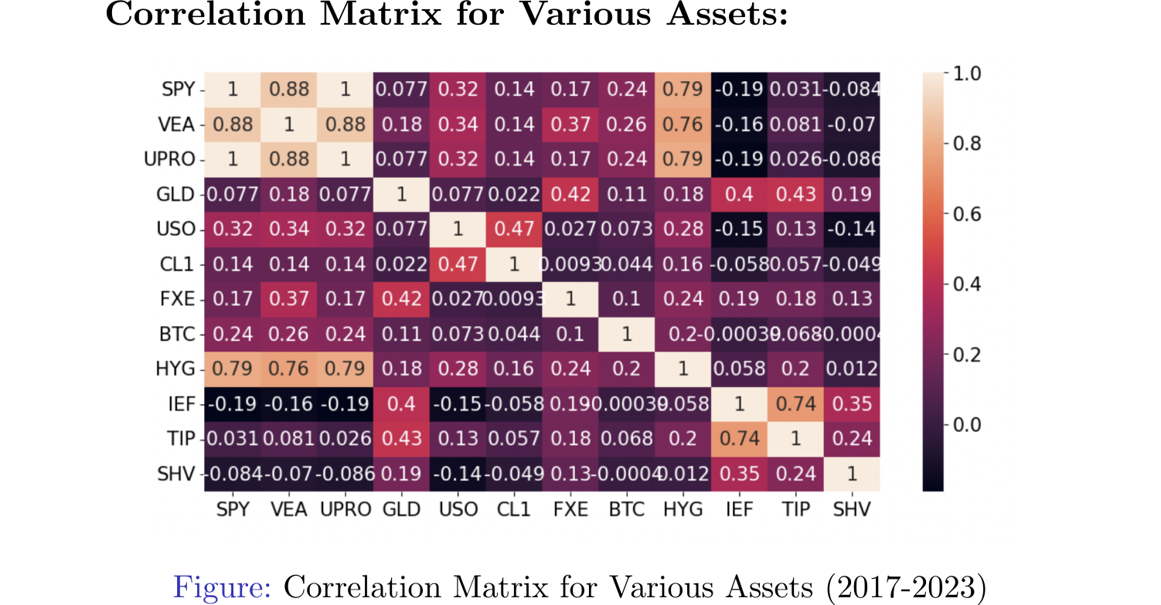
Correlation Matrix Analysis

Slide 42
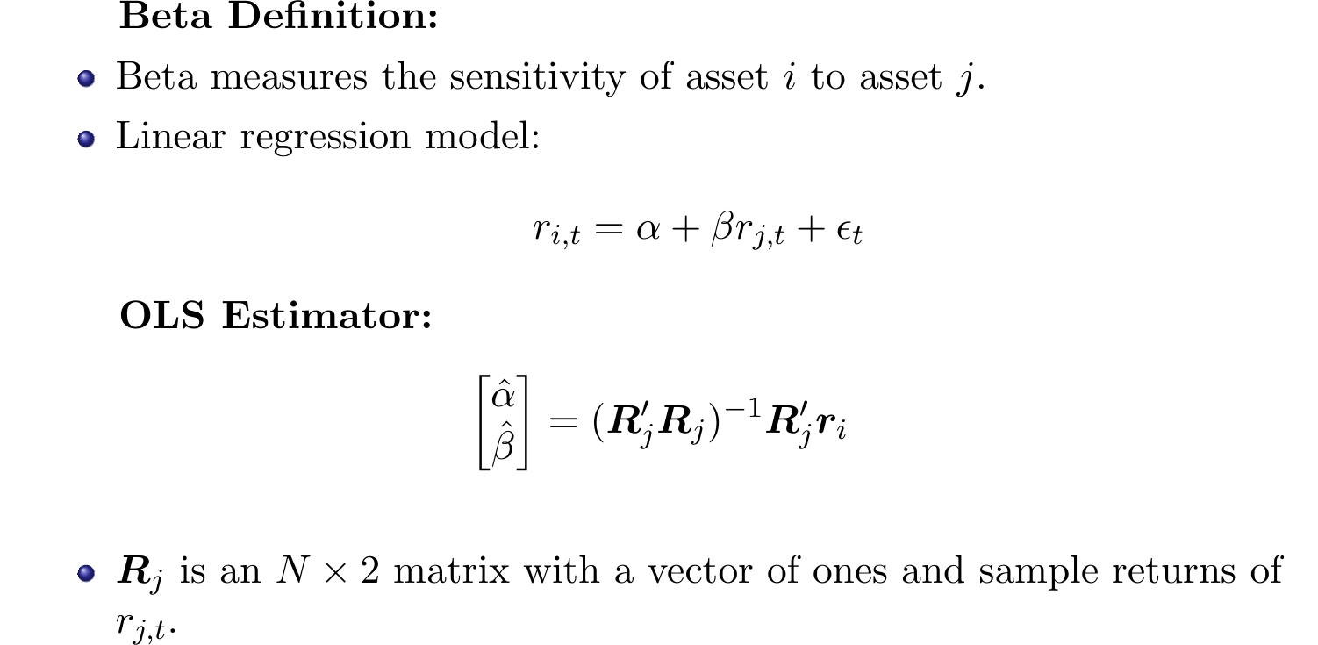
Understanding Beta: Linear Decomposition

Slide 43
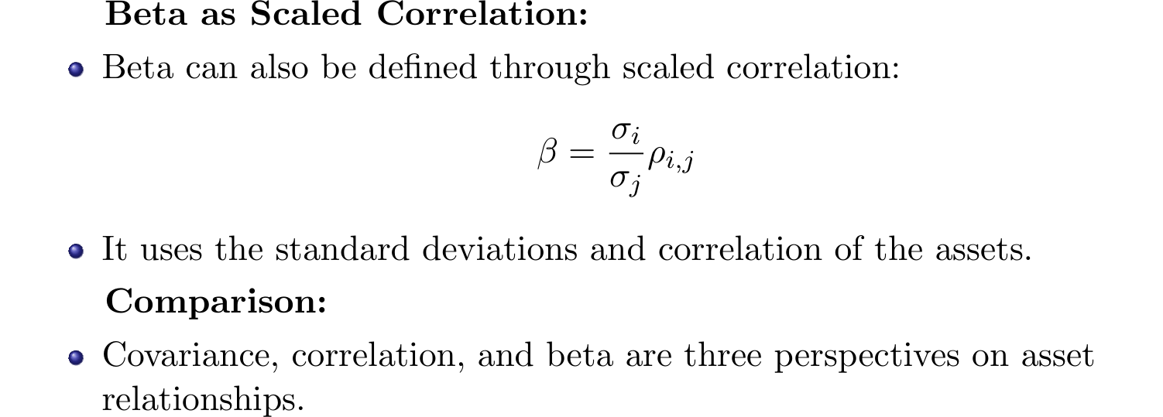
Scaled Correlation and Beta

Slide 44
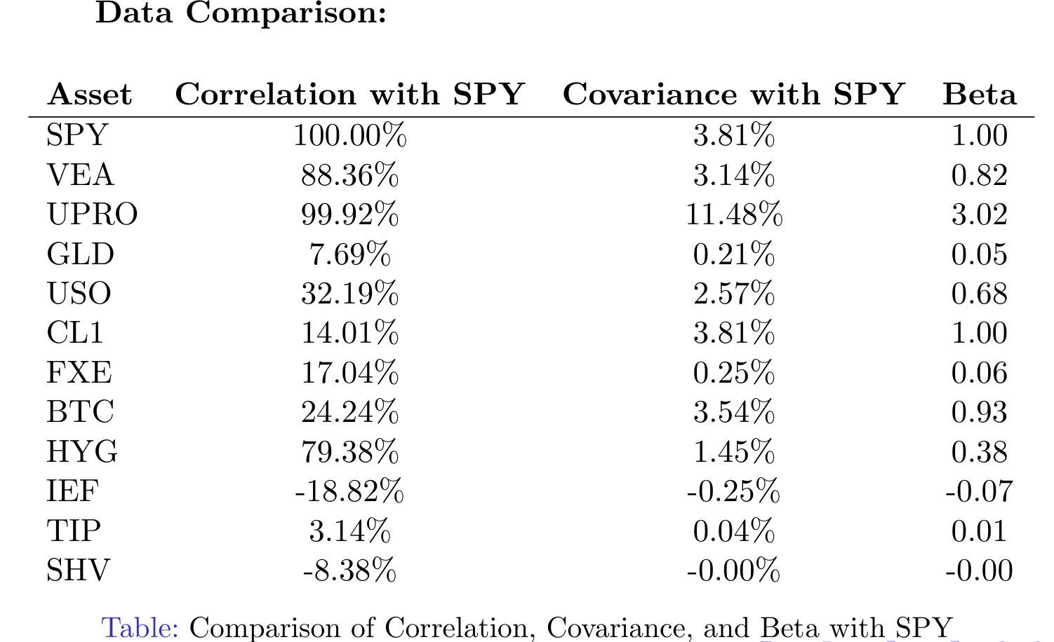
Data Comparison:

Slide 45
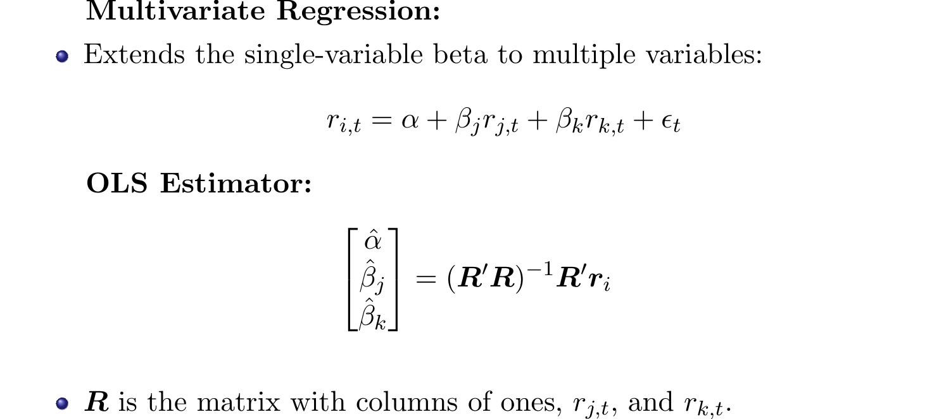
Multivariate Beta

Slide 46
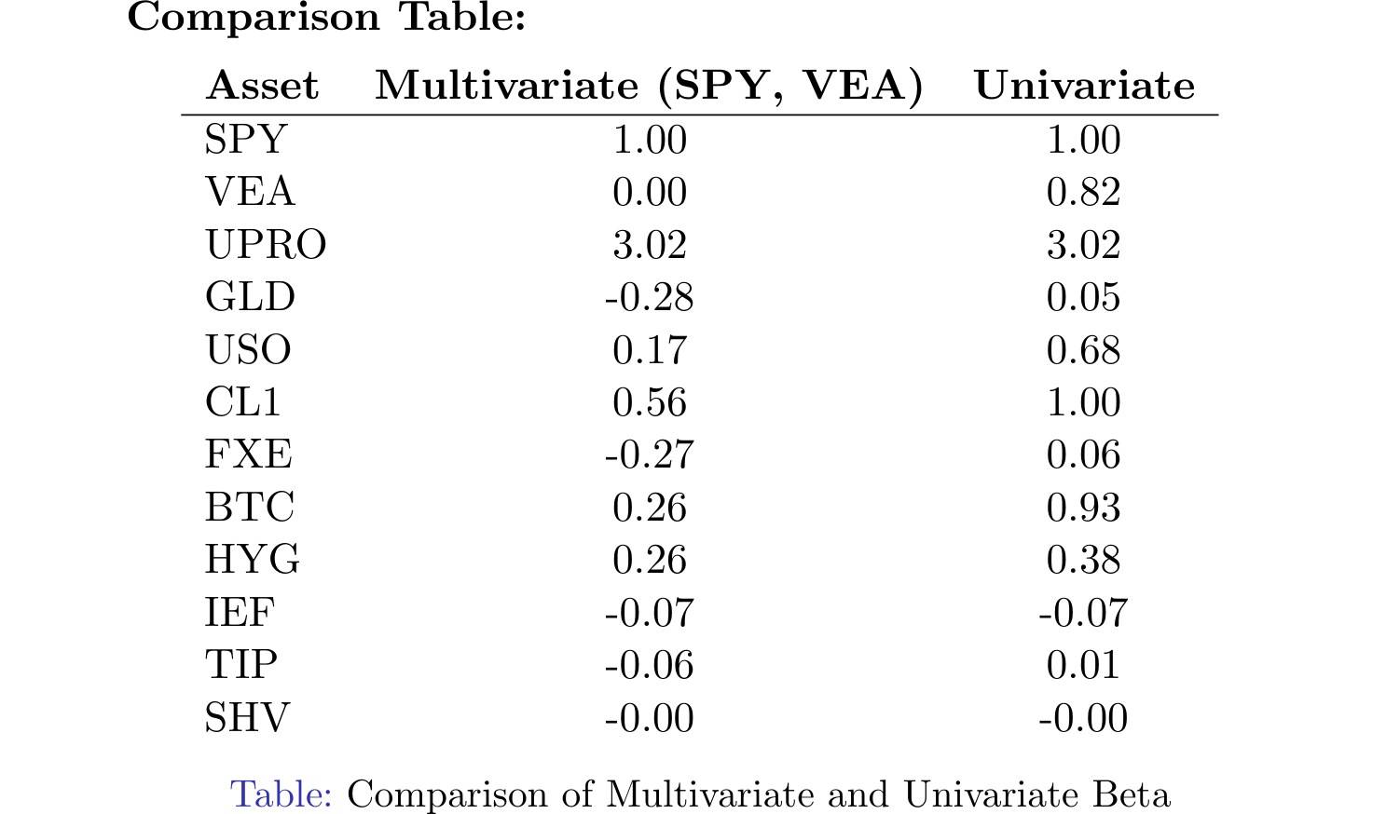
Comparison of Multivariate and Univariate Beta

Slide 47
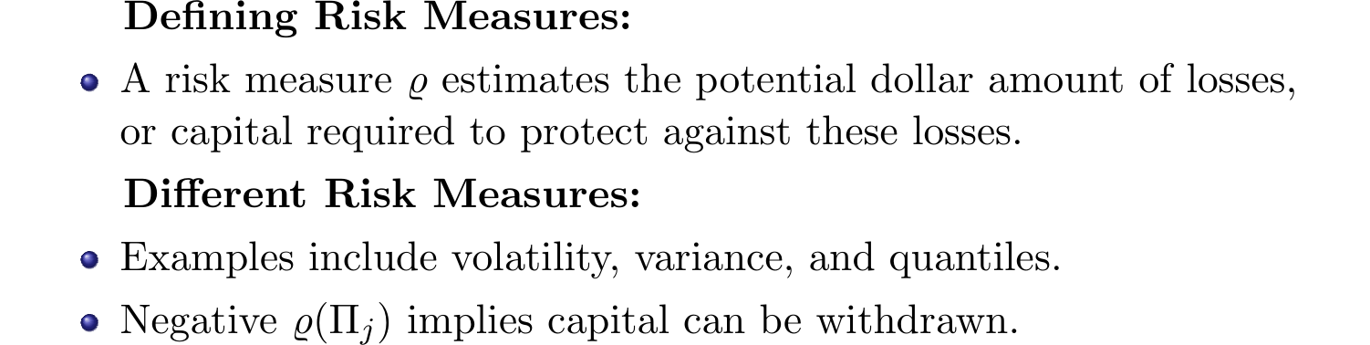
Coherent Risk Measures

Slide 48
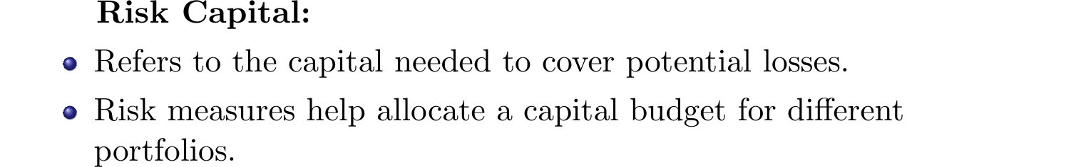
Risk Capital

Slide 49
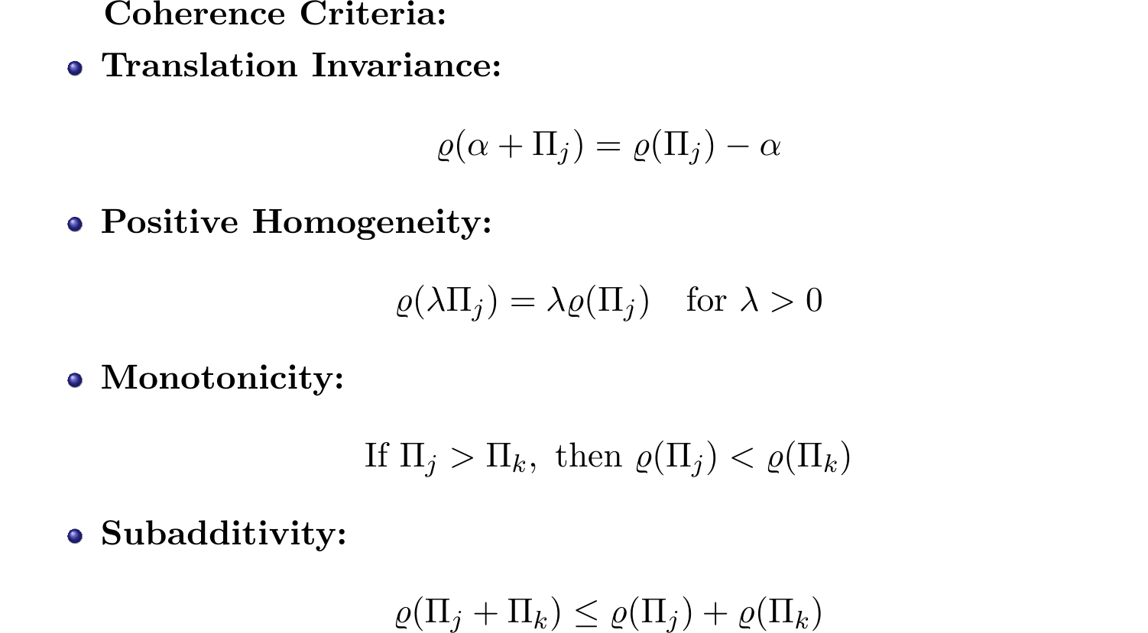
Properties of a Coherent Risk Measure

Slide 50
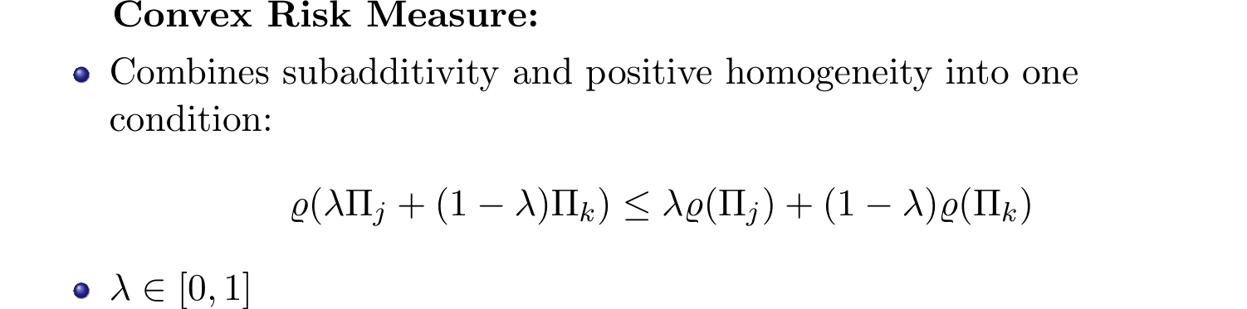
Convex Risk Measure

Slide 51
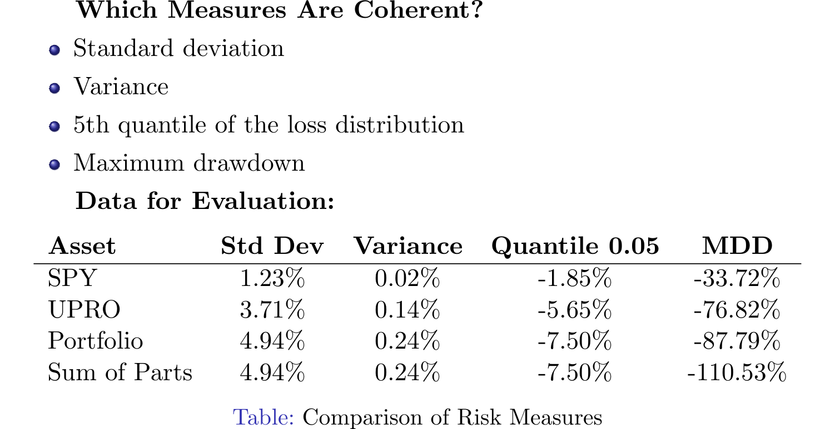
Coherence of Risk Measures

Slide 52
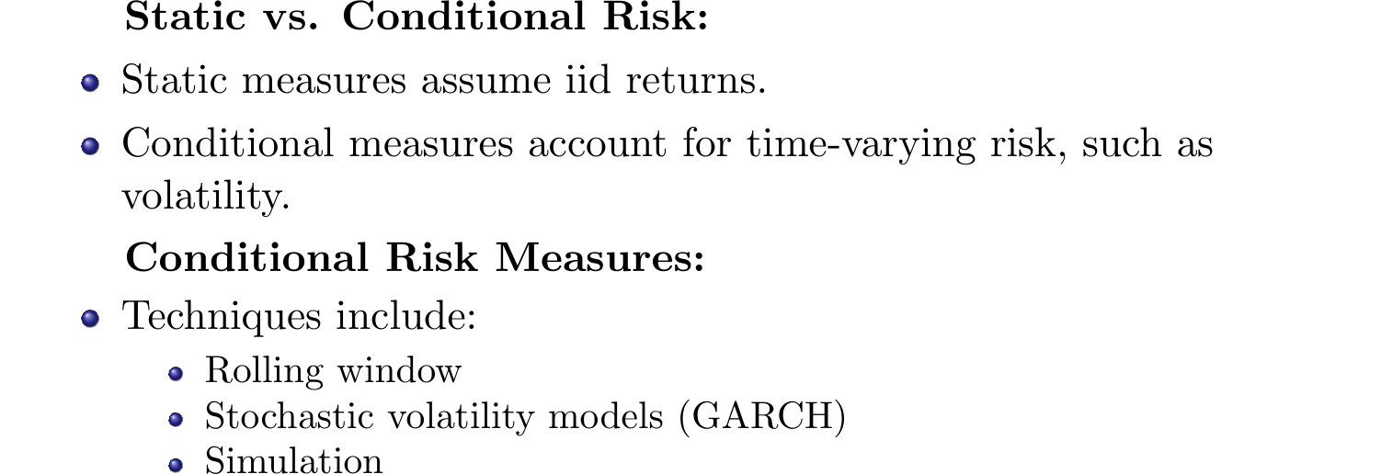
Dynamic Risk Measures

Slide 53

Value at Risk (VaR)

Slide 54

VaR for Returns

Slide 55

VaR Distribution

Slide 56

Normal Distribution and VaR

Slide 57

Normal Formula for VaR

Slide 58

Lognormal Distribution and VaR

Slide 59

VaR for Log Returns

Slide 60

Conditional Value-at-Risk (CVaR)

Slide 61

Normal Distribution for CVaR

Slide 62

Sufficient Statistics of a Normal Distribution

Slide 63

VaR as a Coherent Risk Measure

Slide 64

Examples of VaR

Slide 65

Example: Returns Not Subadditive

Slide 66

Issue with VaR

Slide 67

Data Example

Slide 68

Normal VaR and Coherence

Slide 69

Conditional Moments

Slide 70

Ignoring the Mean

Slide 71

Volatility Estimates

Slide 72

EWMA for Volatility

Slide 73

IGARCH and GARCH

Slide 74

Evaluating VaR

Slide 75

Simulation Methods for VaR

Slide 76

Historical Simulation

Slide 77

CVaR Calculation

Slide 78

Advantages of Historical Simulation

Slide 79

Disadvantages of Historical Simulation

Slide 80

Monte Carlo Simulation

Slide 81

Simulating Bonds and Options

Slide 82

Other Approaches for VaR

Slide 83

Historic Simulation: Empirical CDF

Slide 84

Calculating CVaR with Empirical CDF

Slide 85

Advantages of Historical Simulation

Slide 86

Disadvantages of Historical Simulation

Slide 87

Monte Carlo Simulation

Slide 88

Monte Carlo for Bonds and Options

Slide 89

Alternative Distributions for VaR

Slide 90

Thank You! Questions or Comments? Contact:

